Slide 1
Evensong
For the Fifth Sunday in Lent.

Slide 2
The traditional Evensong service is a contemplative worship in which the prayers are lead by a choir and the congregation participates through listening and enjoyment. During this time when there are not gatherings in churches, we are offering a variation on the Evensong service. There are links to recorded versions of evening prayer as well. In some cases the text of the recording are provided in the video. The psalm, scripture readings, and prayers are provided for your own devotion. There is also a moment of music provided at the end of the order. This is an experiment and we will figure out new ways to hopefully improve the spiritual devotion aspects of this.

Slide 3
Preces by William Smith 1603-1645 Sung by Seraphic Fire Choir Listen The Preces conclude at 1:15 with The Lord’s Name be Praised.

Slide 4
Phos Hilaron
Hail Gladdening Light, of His pure glory poured, who is the immortal father, heavenly blessed.Holiest of Holies, Jesus Christ, our Lord.Now we are come to the Sun's hour of rest. The lights of evening round us shine.We hymn the Father, Son and Holy Spirit divine. Worthiest art thou, at all times to be sung, with undefiled toungue. Son of our God, giver of life alone.Therefore in all the world, thy glories Lord they own.
Setting by Sir John Stainer.
Sung by the choir of Christ Church, New Haven.

Slide 5
Psalm 145 Exaltabo te, Deus
I will exalt you, O God my King, * and bless your Name for ever and ever.
Every day will I bless you * and praise your Name for ever and ever.
Great is the Lord and greatly to be praised; * there is no end to his greatness.
One generation shall praise your works to another * and shall declare your power.
I will ponder the glorious splendor of your majesty * and all your marvelous works.
They shall speak of the might of your wondrous acts, * and I will tell of your greatness.
They shall publish the remembrance of your great goodness; * they shall sing of your righteous deeds.
The Lord is gracious and full of compassion, * slow to anger and of great kindness.
The Lord is loving to everyone * and his compassion is over all his works.
All your works praise you, O Lord, * and your faithful servants bless you.
They make known the glory of your kingdom * and speak of your power;
That the peoples may know of your power * and the glorious splendor of your kingdom.
Your kingdom is an everlasting kingdom; * your dominion endures throughout all ages.
The Lord is faithful in all his words * and merciful in all his deeds.
The Lord upholds all those who fall; * he lifts up those who are bowed down.
The eyes of all wait upon you, O Lord, * and you give them their food in due season.
You open wide your hand * and satisfy the needs of every living creature.
The Lord is righteous in all his ways * and loving in all his works.
The Lord is near to those who call upon him, * to all who call upon him faithfully.
He fulfills the desire of those who fear him; * he hears their cry and helps them.
The Lord preserves all those who love him, * but he destroys all the wicked.
My mouth shall speak the praise of the Lord; * let all flesh bless his holy Name for ever and ever.
Glory be to the Father, and to the Son, and to the Holy Ghost. As it was in the beginning, is now, and ever shall be; world without end. Amen.

Slide 6
The First Lesson. Romans 12:1-21
I appeal to you therefore, brothers and sisters, by the mercies of God, to present your bodies as a living sacrifice, holy and acceptable to God, which is your spiritual worship. Do not be conformed to this world, but be transformed by the renewing of your minds, so that you may discern what is the will of God—what is good and acceptable and perfect. For by the grace given to me I say to everyone among you not to think of yourself more highly than you ought to think, but to think with sober judgment, each according to the measure of faith that God has assigned. For as in one body we have many members, and not all the members have the same function, so we, who are many, are one body in Christ, and individually we are members one of another. We have gifts that differ according to the grace given to us: prophecy, in proportion to faith; ministry, in ministering; the teacher, in teaching; the exhorter, in exhortation; the giver, in generosity; the leader, in diligence; the compassionate, in cheerfulness. Let love be genuine; hate what is evil, hold fast to what is good; love one another with mutual affection; outdo one another in showing honor. Do not lag in zeal, be ardent in spirit, serve the Lord. Rejoice in hope, be patient in suffering, persevere in prayer. Contribute to the needs of the saints; extend hospitality to strangers. Bless those who persecute you; bless and do not curse them. Rejoice with those who rejoice, weep with those who weep. Live in harmony with one another; do not be haughty, but associate with the lowly; do not claim to be wiser than you are. Do not repay anyone evil for evil, but take thought for what is noble in the sight of all. If it is possible, so far as it depends on you, live peaceably with all. Beloved, never avenge yourselves, but leave room for the wrath of God; for it is written, “Vengeance is mine, I will repay, says the Lord.” No, “if your enemies are hungry, feed them; if they are thirsty, give them something to drink; for by doing this you will heap burning coals on their heads.” Do not be overcome by evil, but overcome evil with good.

Slide 7
The Magnificat
My soul doth magnify the Lord, *and my spirit hath rejoiced in God my Savior.For he hath regarded *the lowliness of his handmaiden.For behold from henceforth *all generations shall call me blessed.For he that is mighty hath magnified me, *and holy is his Name.And his mercy is on them that fear him *throughout all generations.He hath showed strength with his arm; *he hath scattered the proud in the imagination of their hearts.He hath put down the mighty from their seat, *and hath exalted the humble and meek.He hath filled the hungry with good things, *and the rich he hath sent empty away.He remembering his mercy hath holpen his servant Israel, *as he promised to our forefathers,Abraham and his seed for ever. Glory to the Father, and to the Son, and to the Holy Spirit: *as it was in the beginning, is now, and will be for ever. Amen.
Listen to a Choral Setting.

Slide 8
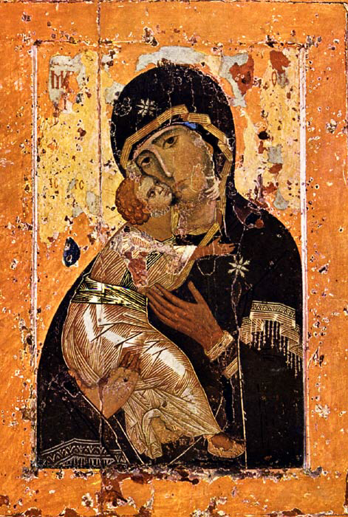

Slide 9
The Second Lesson. John 8:46-59
Jesus said to the crowd, “Which of you convicts me of sin? If I tell the truth, why do you not believe me? Whoever is from God hears the words of God. The reason you do not hear them is that you are not from God.” The Jews answered him, “Are we not right in saying that you are a Samaritan and have a demon?” Jesus answered, “I do not have a demon; but I honor my Father, and you dishonor me. Yet I do not seek my own glory; there is one who seeks it and he is the judge. Very truly, I tell you, whoever keeps my word will never see death.” The Jews said to him, “Now we know that you have a demon. Abraham died, and so did the prophets; yet you say, ‘Whoever keeps my word will never taste death.’ Are you greater than our father Abraham, who died? The prophets also died. Who do you claim to be?” Jesus answered, “If I glorify myself, my glory is nothing. It is my Father who glorifies me, he of whom you say, ‘He is our God,’ though you do not know him. But I know him; if I would say that I do not know him, I would be a liar like you. But I do know him and I keep his word. Your ancestor Abraham rejoiced that he would see my day; he saw it and was glad.” Then the Jews said to him, “You are not yet fifty years old, and have you seen Abraham?” Jesus said to them, “Very truly, I tell you, before Abraham was, I am.” So they picked up stones to throw at him, but Jesus hid himself and went out of the temple.

Slide 10
The Nunc Dimittis
Lord, now lettest thou thy servant depart in peace, *according to thy word;For mine eyes have seen thy salvation, *which thou hast prepared before the face of all people,To be a light to lighten the Gentiles, *and to be the glory of thy people Israel. Glory to the Father, and to the Son, and to the Holy Spirit: *as it was in the beginning, is now, and will be for ever. Amen.
Listen to a choral setting.

Slide 11
The Creed
I believe in God, the Father almighty, maker of heaven and earth;And in Jesus Christ his only Son our Lord; who was conceived by the Holy Ghost, born of the Virgin Mary, suffered under Pontius Pilate, was crucified, dead, and buried. He descended into hell.The third day he rose again from the dead. He ascended into heaven, and sitteth on the right hand of God the Father almighty. From thence he shall come to judge the quick and the dead.I believe in the Holy Ghost, the holy catholic Church, the communion of saints, the forgiveness of sins, the resurrection of the body, and the life everlasting. Amen.

Slide 12
The prayers after the creed.
Listen to the Prayers, setting by William Smith.
Commence Listening at 1 minute, 15 seconds.
Listen Here.
The first collect chanted in this recording is for Christmas. To listen to the other two collects (printed on the following slides) skip to
4 minutes, 2 seconds.

Slide 13
Collect for the Fifth Sunday in Lent.
Almighty God, who alone canst order the unruly wills and affections of sinful men: Grant unto thy people that they may love the thing which thou commandest, and desire that which thou dost promise; that so, among the sundry and manifold changes of the world,
our hearts may surely there be fixed where true joys are to be found; through Jesus Christ our Lord, who liveth and reigneth with thee and the Holy Spirit, one God, now and for ever. Amen.

Slide 14
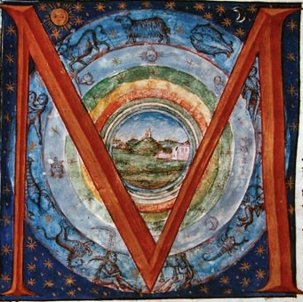
A collect for peace.
ost holy God, the source of all good desires, all right judgments, and all just works: Give to us, your servants, that peace which the world cannot give, so that our minds may be fixed on the doing of your will, and that we, being delivered from the fear of all enemies, may live in peace and quietness; through the mercies of Christ Jesus our Savior. Amen.

Slide 15
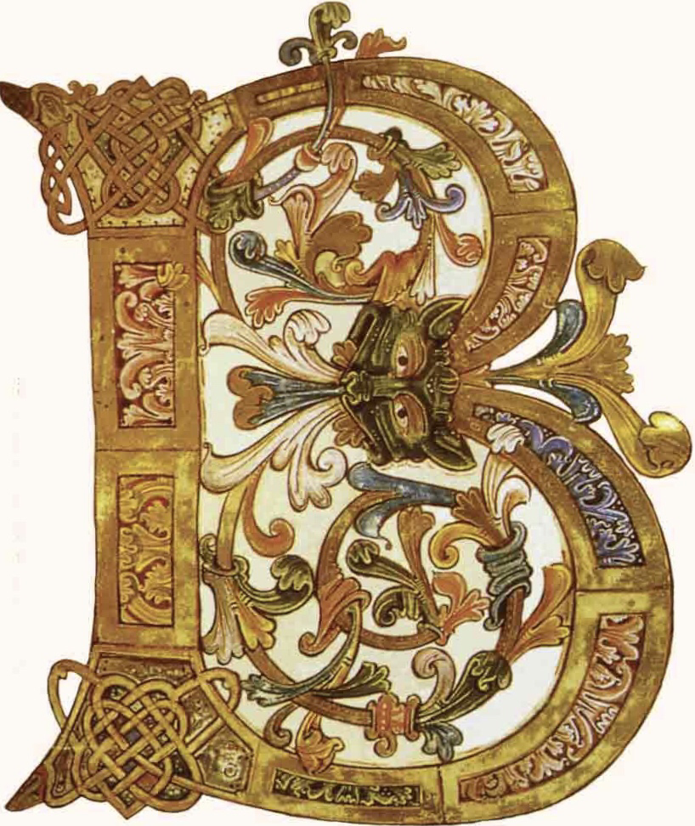
A collect for aid against perils.
e our light in the darkness, O Lord, and in your great mercy defend us from all perils and dangers of this night; for the love of your only Son, our Savior Jesus Christ. Amen

Slide 16
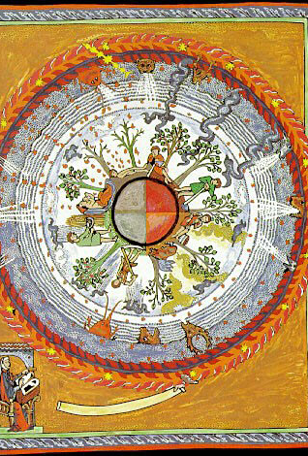
KEEP WATCH, dear Lord, with those who work, or watch, or weep this night, and give thine angels charge over those who sleep. Tend the sick, Lord Christ; give rest to the weary, bless the dying, soothe the suffering, pity the afflicted, shield the joyous; and all for thy love’s sake. Amen.

Slide 17
A Prayer of St. Chrysostom.
Almighty God, who hast given us grace at this time with one accord to make our common supplication unto thee, and hast promised through thy well-beloved Son that when two or three are gathered together in his Name thou wilt be in the midst of them: Fulfill now, O Lord, the desires and petitions of thy servants as may be best for us; granting us in this world knowledge of thy truth, and in the world to come life everlasting. Amen.

Slide 18
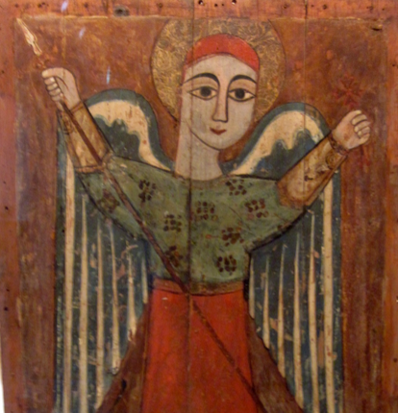
May the God of hope fill us with all joy and peace in believing through the power of the Holy Spirit. Amen. Romans 15:13

Slide 19
Postlude meditation.
A time of quiet reflection with mbira music.
Listen here.

